Slide 1


Road Haulage Tracking & Performance
Ahmad Mathusin

Slide 2
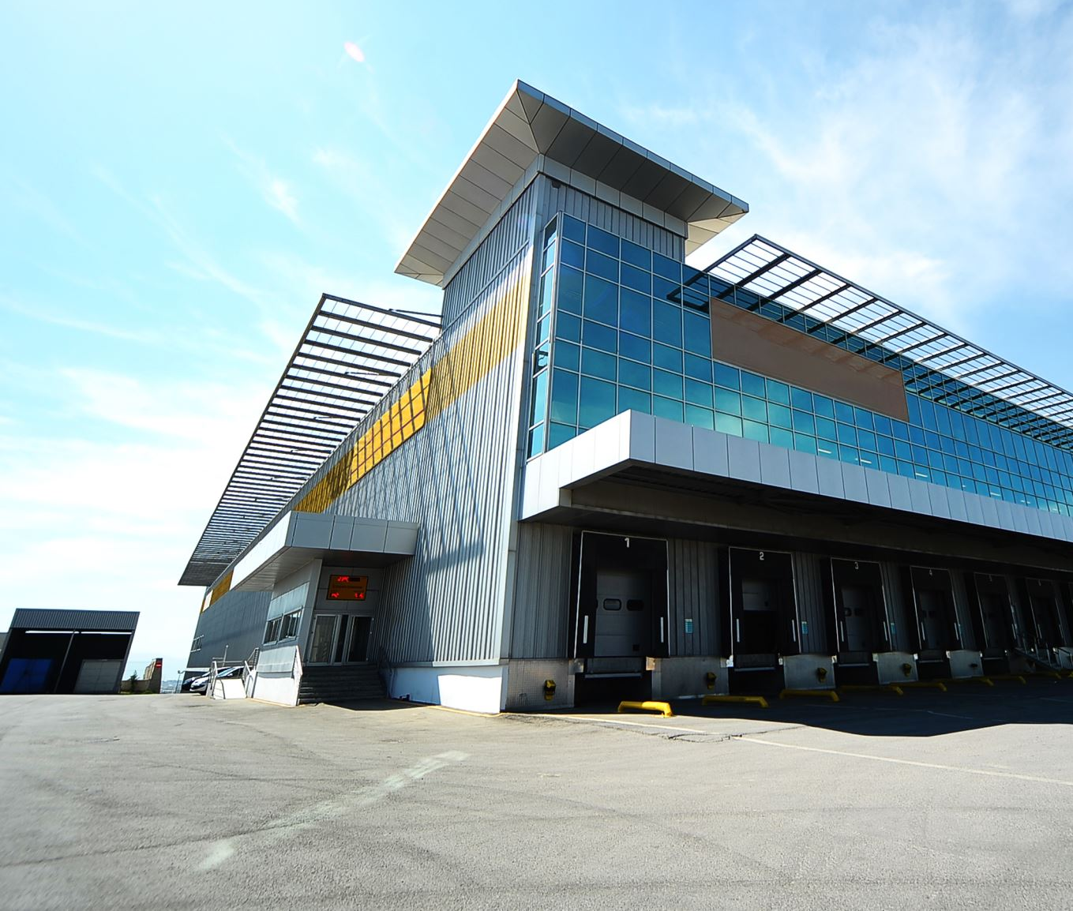
Introduction
Road haulage is essential for the people and businesses of the UK. Approximately 90% of all goods transported by land in Great Britain are moved directly by road.
DigiHaul is a digital transport business, specialising in managing, consolidating and integrating data from both Carriers and Shippers to deliver seamless end-to-end logistics service.
Shippers book shipments on the DigiHaul platform, detailing the scheduled collection and delivery time windows / locations and required vehicle types for carriers to consider.
Once a carrier accepts a job and collection is scheduled, DigiHaul’s driver app facilitates real-time tracking of shipments through GPS signals, subject to carriers granting permissions for location logging.

Slide 3
Content
Data
Data Summary & KPIs
Assumptions
Findings
Carrier Performance
Identify On-Time & Delayed Shipment
Delay Notification
Identify Late Collection
Identify Late Delivery
4. Delay Prediction
Predictors
Feature Transformation
Modelling Pipeline
Model Evaluation & Selection
Prediction
5. Next Steps

Slide 4


Data Summary & KPIs
Datasets
KPIs
GPS – 600K+ rows of tracking data of shipments from 1st Oct – 31st Dec 2023
Historical Shipment Bookings – 3K+ rows of past booking data from approximately 1st Oct – 31st Dec 2023
New Shipment Bookings – 1K rows of past booking data from approximately 10th Jan – 20th Jan 2024
On-time delivery
is defined by reaching the destination no later than 30 minutes past the scheduled delivery window
Delay Notification – shippers are notified when:
a carrier doesn’t reach its collection point at the latest collection window time
a carrier doesn’t reach its delivery destination at the earliest delivery window time

Slide 5
Assumptions & Limitations
1
2
3
Postcodes are obtained from GPS coordinates using ‘postcodes.io’ API, but there are other APIs which have lower distance threshold for a match i.e. a postcode is provided even though the distance is very far from a registered postcode
A shipment’s final coordinates that don’t match its delivery postcode is assumed to have not reached its delivery destination by 31st October 2023
Carriers might have to park at coordinates that are not close enough to a postcode that the API could match

Slide 6
Assumptions & Limitations
4
5
6
Shipment postcodes that don't match the exact destination postcodes might have reached their destination by other means due to parking restrictions/availability
A shipment is assumed to have reached its destination if at least all but the last character of the GPS tracking postcode match that of the intended destination
Only 36 out of 3,245 carriers’ GPS postcodes match their collection postcodes, but 585 reached their delivery postcodes which suggests the unmatched collection postcodes might not reveal the full picture. These carriers would’ve reached their collection somehow or they wouldn’t have made the journey to the delivery location unless they made an error.

Slide 7



Carrier Performance (On-Time vs Delayed)
82% of shipments didn’t reach their destination
4% of shipments didn’t reach their destination on time
Only 14% of shipments reached their destination on time

Slide 8

Delay Notification Late Collection
Shippers are notified when
Tracking timestamp is later than the earliest scheduled collection
and
Tracking location matches the collection postcode
There are 20 shipments whose shippers should’ve been notified of potential late collection
The rest
never reached their collection points (based on only 36 postcode matches which might not be reliable)
or
reached their collection points after the latest scheduled collection (outside collection window)
Delay notification
collection window
earliest
latest

Slide 9

Delay Notification Late Delivery
Shippers are notified when
Tracking timestamp is later than the earliest scheduled delivery
and
Tracking location matches the delivery postcode
There are 317 shipments whose shippers should’ve been notified of potential late delivery
The rest
never reached their delivery location
or
reached their delivery locations after the earliest scheduled delivery but still within the delivery window
or
reached their delivery locations after the latest scheduled delivery (outside delivery window)
Delay notification
delivery window
earliest
latest

Slide 10
Delay Prediction Predictors
Predictors
Findings
Column Name | Explanation
VEHICLE_SIZE | Vehicle type
VEHICLE_BUILD_UP | Vehicle trailer build up
FIRST_COLLECTION_POST_CODE | Collection post code
LAST_DELIVERY_POST_CODE | Delivery post code (can be NULL)
FIRST_COLLECTION_LATITUDE | Collection latitude
FIRST_COLLECTION_LONGITUDE | Collection longitude
LAST_DELIVERY_LATITUDE | Delivery latitude
LAST_DELIVERY_LONGITUDE | Delivery longitude
SHIPPER_ID is not a predictor but is missing from Shipment_bookings dataset
4 LAST_DELIVERY_POST_CODEs are missing from Shipment_bookings – no postcode matches found using the API
2 FIRST_COLLECTION_POST_CODEs are missing from New_bookings dataset – no postcode matches found using the API

Slide 11
Delay Prediction Feature Transformation
New variables are derived using the following calculations and are added to the list of predictors
Durations
Time between collection & delivery
Collection & delivery window
Distances
Difference between GPS coordinates of collection point
Difference between GPS coordinates of delivery location

Slide 12
Modelling Pipeline
Data Transformation
Feature Engineering
Feature Selection
Training & Fitting
Train & fit model on 3 types of classifiers:
Model Evaluation
Classification Report
AUC
Categorical Feature Encoding
Logistic Regression
Random Forest Classifier
Support Vector Machine

Slide 13
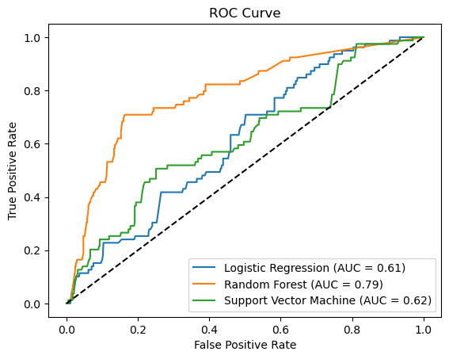
Model Evaluation & Selection
Random Forest is the winning model based on the highest AUC: 0.79. This means its best classifier at distinguishing delayed & on-time delivery.
It also scores the highest in precision & f1-score and 2nd highest on recall
High number of False Negatives (high precision) is better than having high number of False Positives (high recall)
Incorrectly labelling on-time shipments is less detrimental to shippers than incorrectly labelling delayed ones

Slide 14
Model Prediction
When scored against unseen data, the model predicted only 3.8% of 1000 shipments to be on-time

Slide 15
Next Steps
Various feature selection methods could be used to help improve the performance of the final model (e.g. removing collection_window & delivery_window increase the winning model’s AUC from 0.77 to 0.78)
Removing outliers and multicollinear features could also improve the model performance
Sampling techniques could be used to minimise the effect of class imbalance in the dataset. There are only 14% of shipments that delivered on time, so the model is biased towards delayed shipments.
The predictive model could be used to predict delayed shipment so measures could be introduced to minimise delays such as increasing the time window of collection and/or delivery for shipments that are likely to be delayed.
Similarly, if we find predictors that have high correlations with the target variable i.e. factors that likely to influence the speed of delivery, we can improve the number of on-time deliveries.

Slide 16
Next Steps
As a lot of the postcodes couldn’t be matched, other APIs could also be used in addition or instead of postcodes.io to locate the nearest postcode to improve the number of matches.
An API call could also be used to calculate the distance between GPS locations to estimate whether a carrier would reach its collection on time
Time of the day, day of the week or month of the year could be used as variables in the predictive model as they could have significant affect journey time due seasonality in traffic volumes. This requires further data transformation on the date variables.

